Slide 1
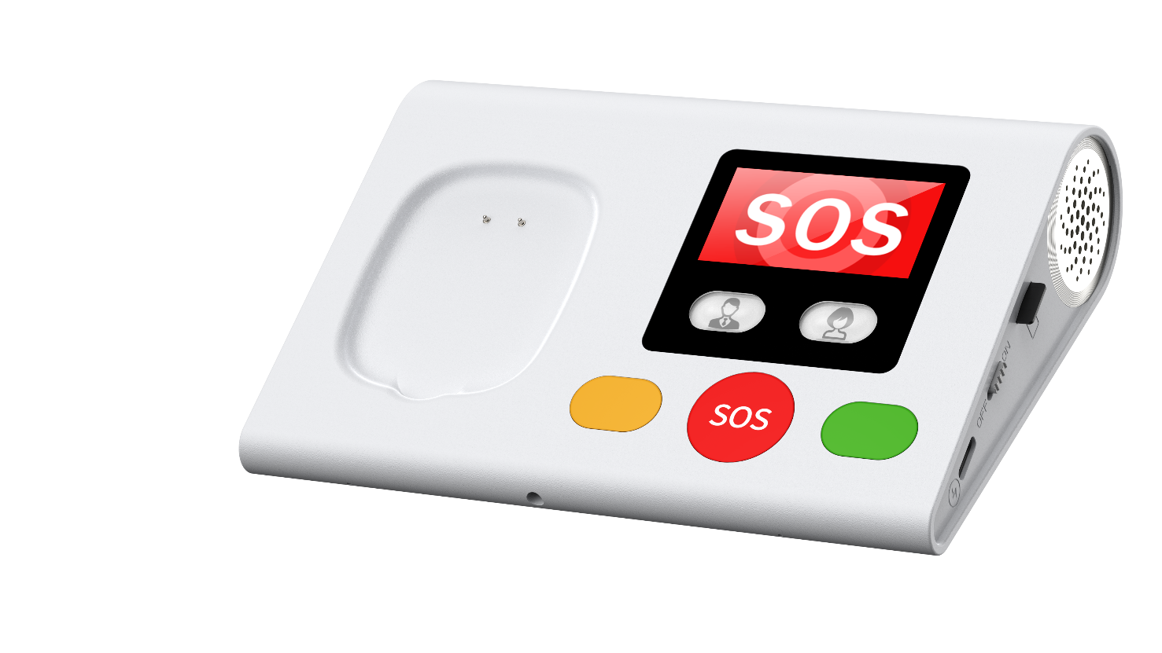
L04 Smart base Introduction
Kim 2024-10-20
Notes:
https://www.pexels.com/zh-tw/photo/747101/
https://www.pexels.com/zh-tw/photo/240572/

Slide 2
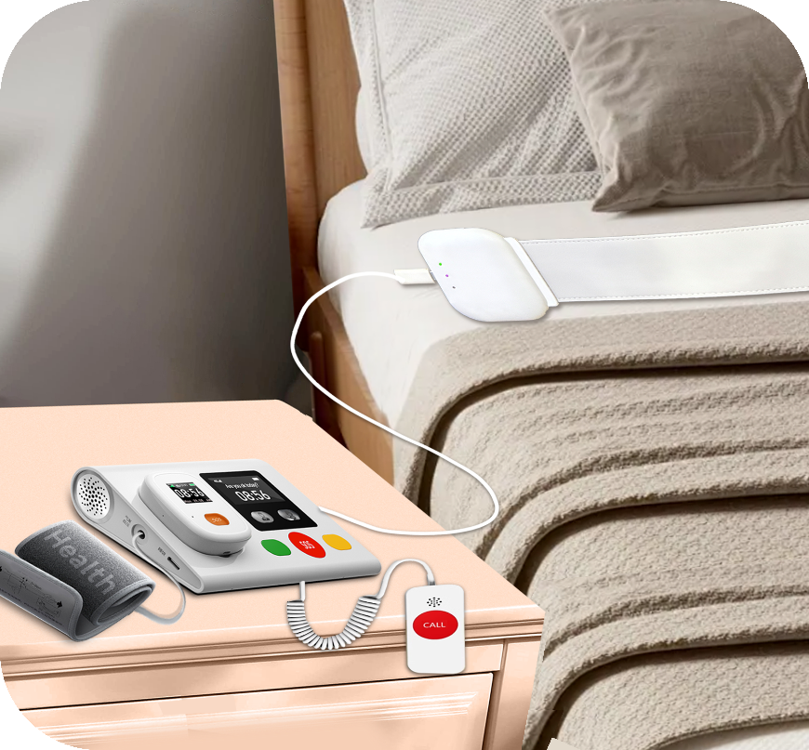
overview
This product is designed and developed specifically for the elderly care industry. It is a good companion for elderly users‘ family safety. The built-in WIFI and 4G communication modules allow users to maintain a tight connection with the service platform. The built-in environmental sensor can closely monitor the user’s living environment and reduce the occurrence of danger. The ultra large volume speakers and sensitive dual microphone settings can make communication between users and the platform more efficient and convenient。Equipped with a built-in blood pressure measurement system and sleep monitoring system, it can constantly monitor users' physiological data. Users can also easily call various medical and lifestyle services through the large buttons
SOS call
Notification
Big Volume
Alarm
Blood
Pressure
Sleep
Monitor
Temperature and humidity
Charge for Tracker

Slide 3
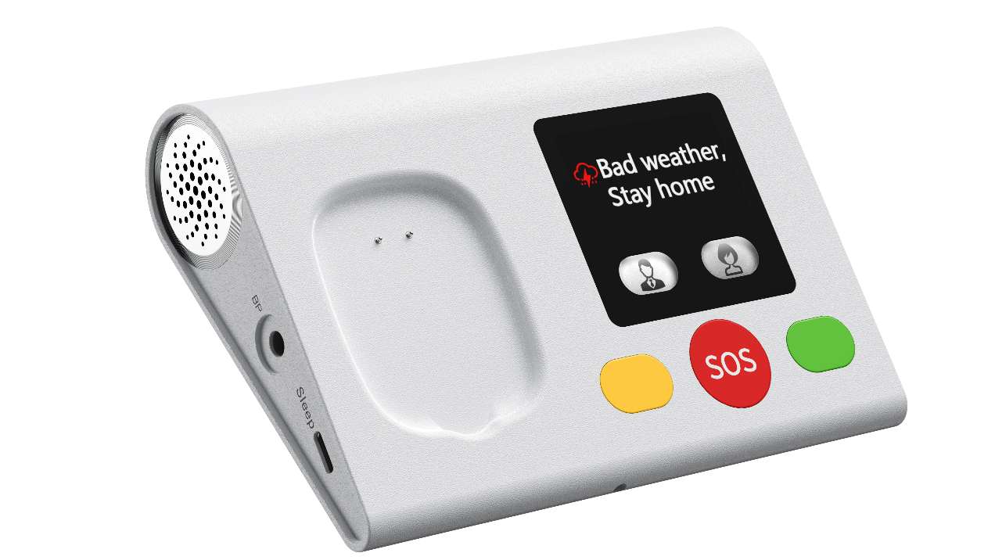
Specification
Spec | Model | L04
 | material | flame retardant plastic
 | Hardware | ESP32-S3
 | LTE Band | GSM：900、1800
 |  | 4G FDD：B1B3 B7 B8 B20 TDD：B38 B39 B40 B41
 | LCD | 1.9 inch IPS 176*320 resolution
 | RF connection | 433MHZ or 869MHZ
 | Firmware OS | RTOS
 | wireless | BLE 5.1，WIFI 2.4G
 | Blood pressure | Optional
 | Antenna | FPC
 | Sleep monitor | Optional
 | SIM | Nano SIM
 | Microphone | Matrix dual microphone
 | Speaker | Dual 3.0W big speakers
 | Battery | Build in 1000 mah
 | Memory | 24M+16M
 | OTA | yes
 | Charge | Type C
 | Keys | 5 keys; 2 keys for blood pressure are optional
 | Dimension | 140mmx100mmx13.5mm or 34.5mm（the highest）
 | Weight | 225g (included blood pressure module)
 | Color | White

Slide 4
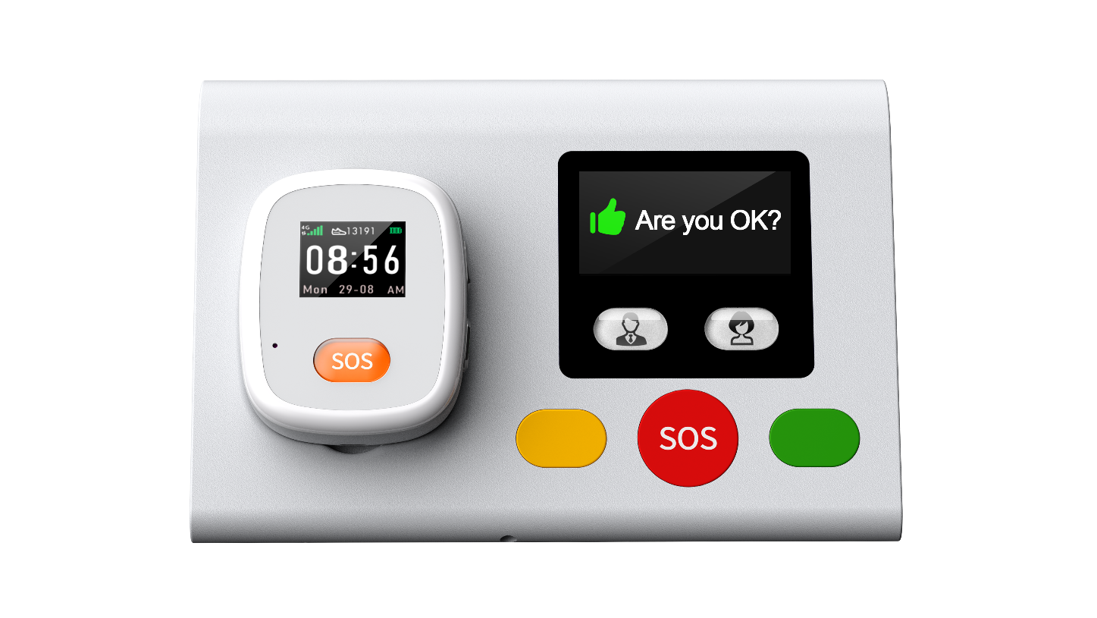
Charging locator/watch, remote service, SOS call
1: The care center can send various text and voice messages to the smart dock. Remind users. The user responds by pressing the green button
2: Long press the red SOS button to establish a voice call with the call center and obtain emergency assistance.
3: Users can also long press the yellow button to access life services and assistance。

Slide 5
Ultra large volume speaker and matrix microphone
1: Left and right stereo speakers, super high volume.
2: 2 microphones, capable of supporting high-definition calls in a 250 square meter space
3: Support platform send voice notifications to base
4: Abnormal detection data, voice alarm

Slide 6
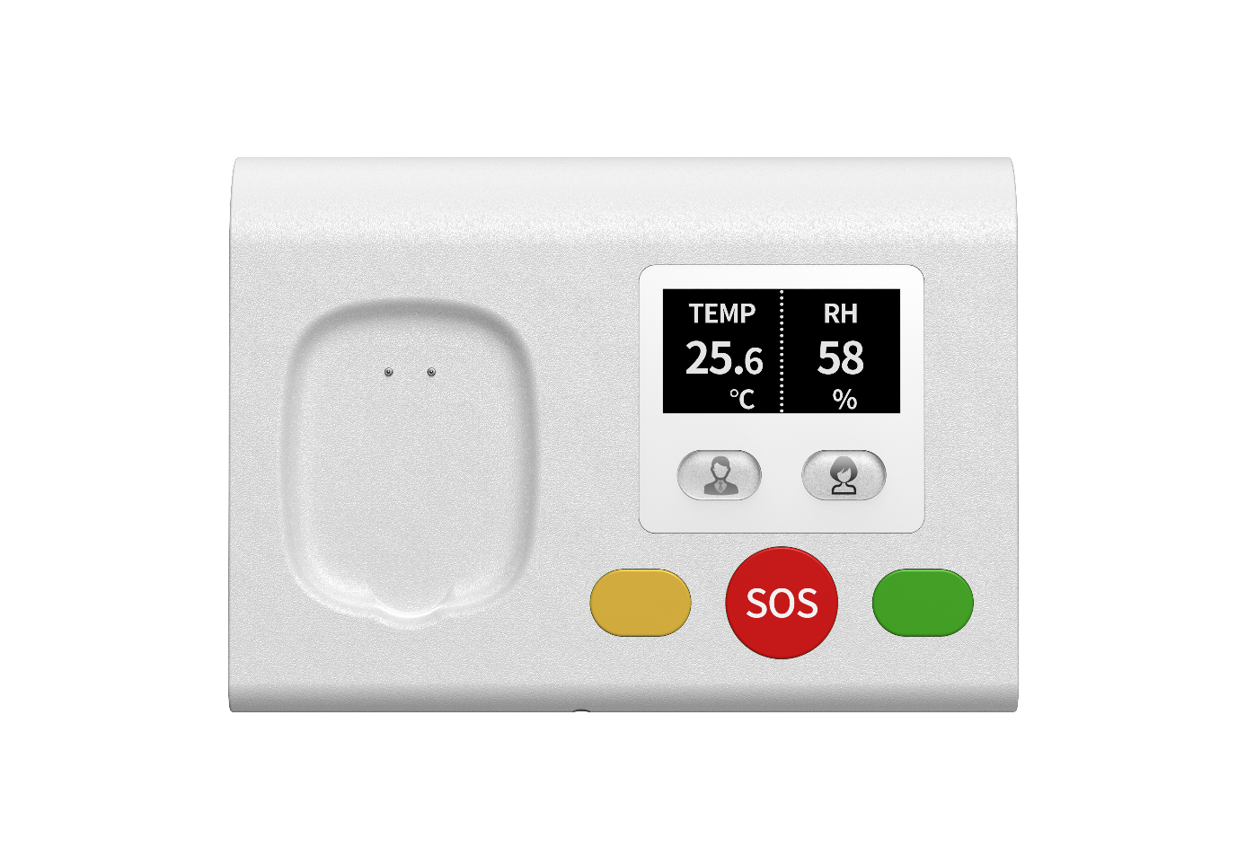
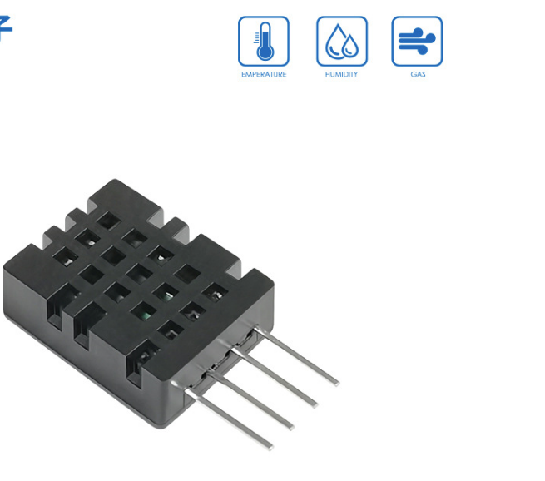
Room temperature and humidity monitoring
Support real-time display of room temperature and humidity
Stay informed about the safety and comfort of the user's environment at all times

Slide 7
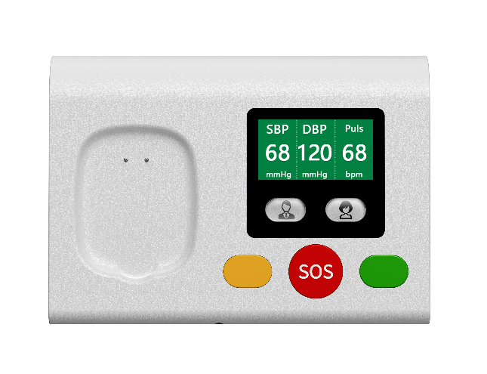
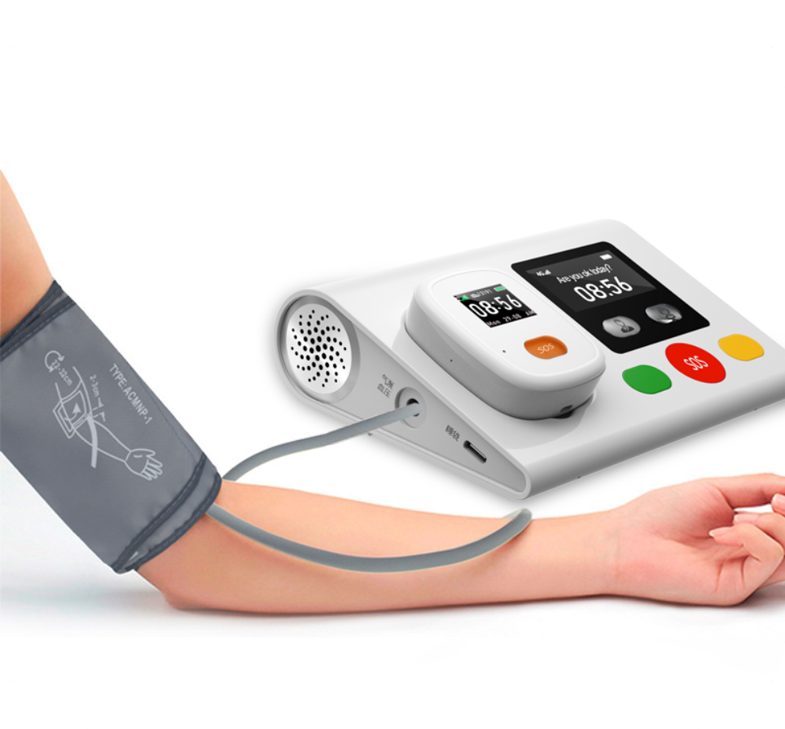
Built in air pump blood pressure monitor
This function is optional and does not have a medical certification
1: The smart base is equipped with an air pump. Accurate blood pressure measurement can be achieved through an external cuff.
2: Two separate buttons. It is possible to collect data from two parents separately and display the data separately on cloud servers
3: All data can be sent to the server via WIFI or 4G

Slide 8
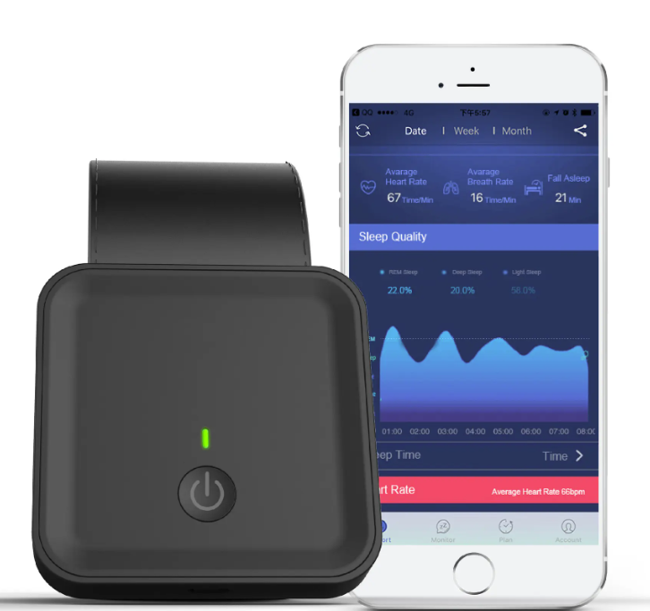
Connect to sleep monitor mattress
1: Lay pressure sensors on the bed.
2: The pressure sensor is powered by the home smart base and the measurement results are transmitted to the cloud server.
3: The data that can be monitored includes wake-up time, bed time, duration of deep and light sleep, heart rate, breathing, and other parameters closely related to the user's sleep quality

Slide 9
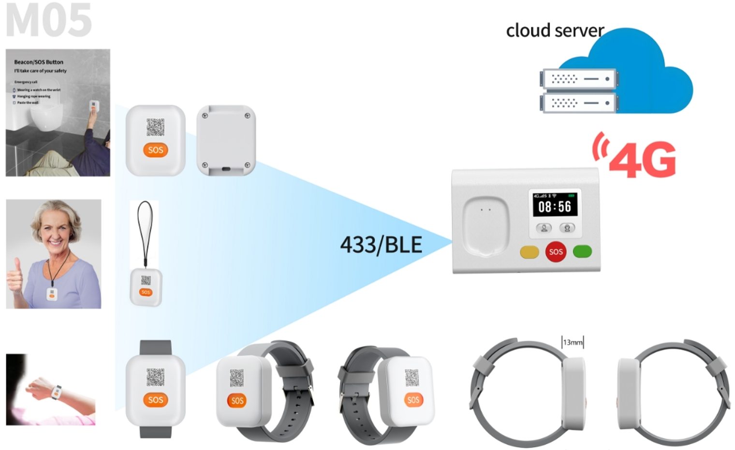
Connect to 433/869MHz SOS button
433 MHZ SOS Button。
Built in a battery that can work for 3 years

Slide 10
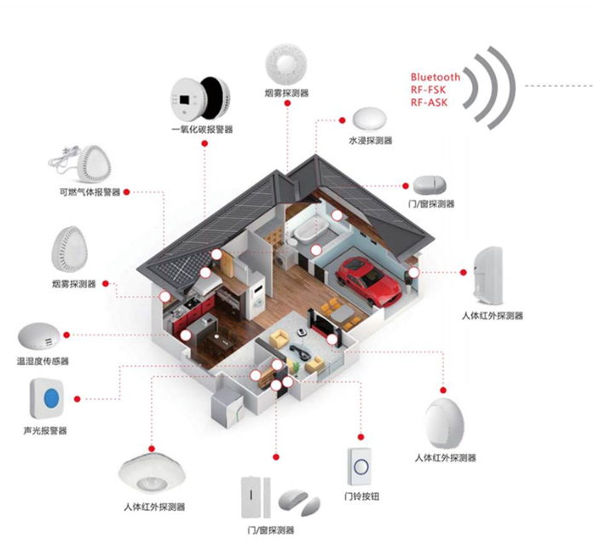
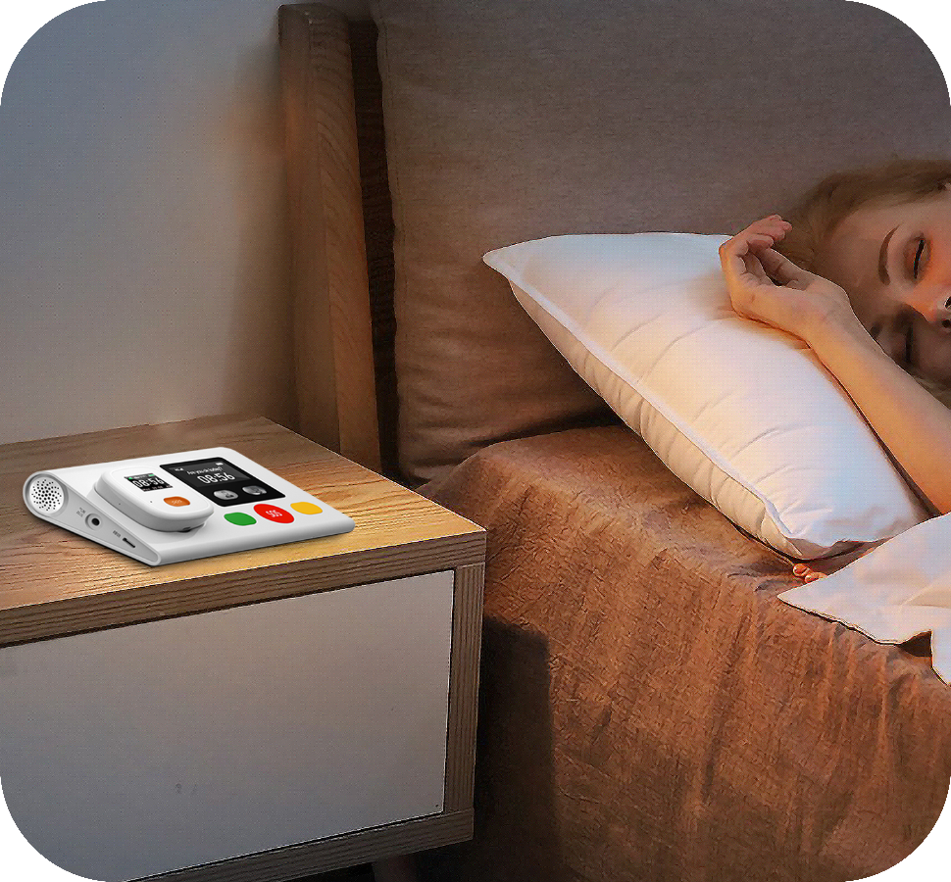
Supports Bluetooth and RF 433MHz/869MHz connection to other devices
1：Can connect smoke sensors, door and window sensors, and more。
2：The smart base will send these sensor data and alarms to the cloud server

Slide 11
Thank you！
Looking forward to working with you to
extend the lifespan of users and improve their quality of life.
Kim Since 2015

